Slide 1
Career Planning: How to Help Your Child
A Career Planning Parent Night Presentation Featuring Kuder Navigator®
We help you see what you can be®
www.kuder.com

Slide 2
“One third of the hours of your waking time is spent at work.
Why not find an occupation you enjoy?”
— JoAnn Harris-Bowlsbey, Ed.D. Take Hold of Your Future

Slide 3
What’s the parent’s role?
Parents are the primary influence on the career development of their children.

Slide 4
What’s the parent’s role?
Read the Kuder Parent’s Guide.
Walks you through the Career Planning Process.

Slide 5
Why is your role so critical?
One of the main reasons students choose not to pursue education after high school is because of lack of encouragement from parents.
Students are often unaware of the career planning steps they need to take.
Parents and schools are an important link to connect students’ education with their career goals.

Slide 6
The Career Planning Process

Slide 7
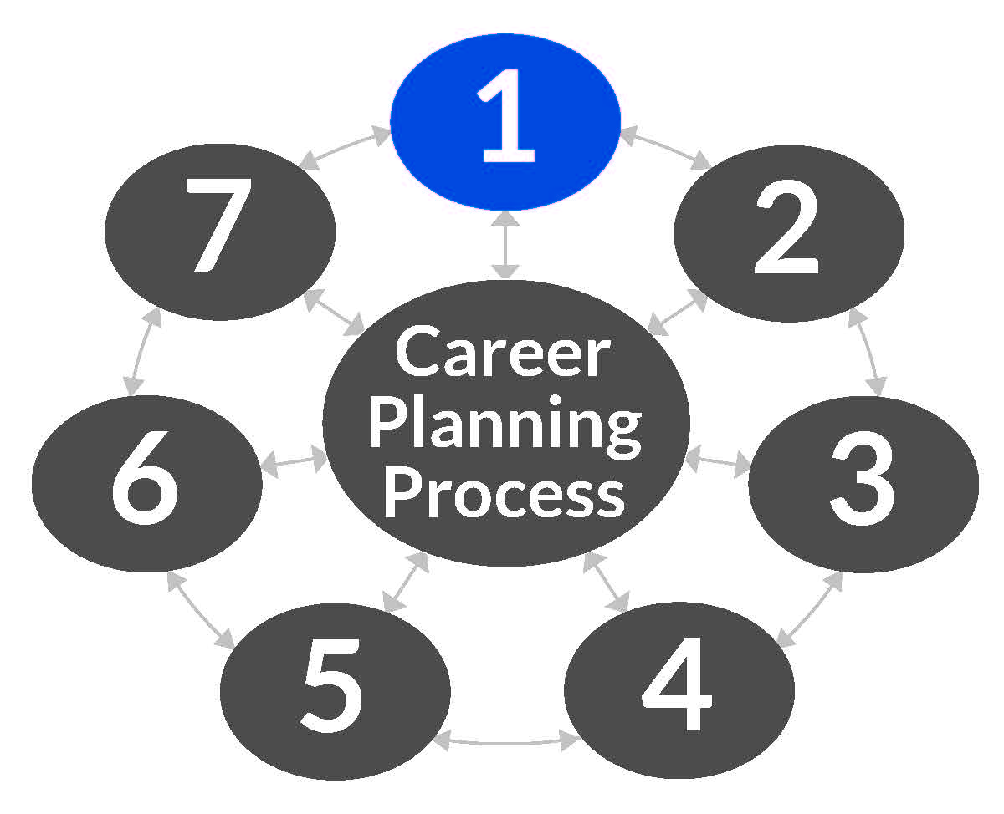
Step 1
Realize career choices must be made.
Teach decision making.
Commend your child for good work or behavior.
All kinds of work are needed and are honorable.
Discuss how careers are organized.

Slide 8
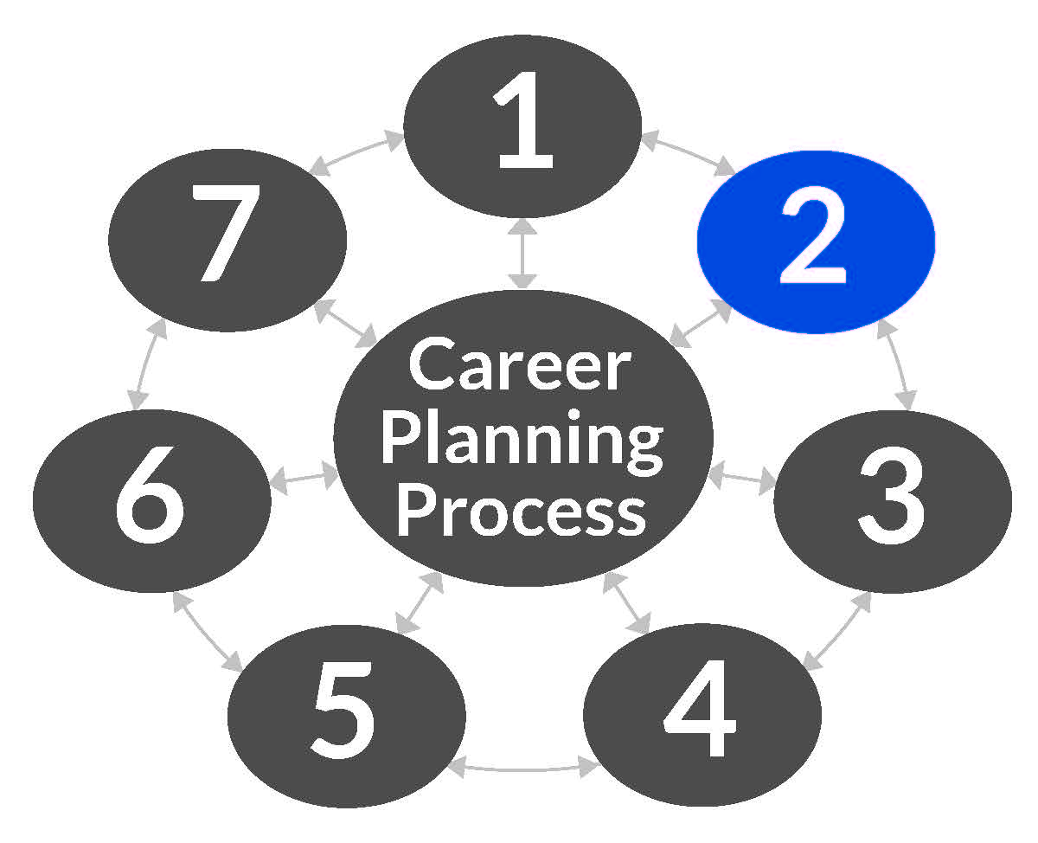
Step 2
Learn what you like to do and what you do well.
Expose your child to a wide variety of activities.
When helping with homework, discuss how skills learned in school may be used in a job.
Utilize Kuder Navigator®.
Encourage your child to use the system to explore careers and education or training options based on his/her assessment results.

Slide 9
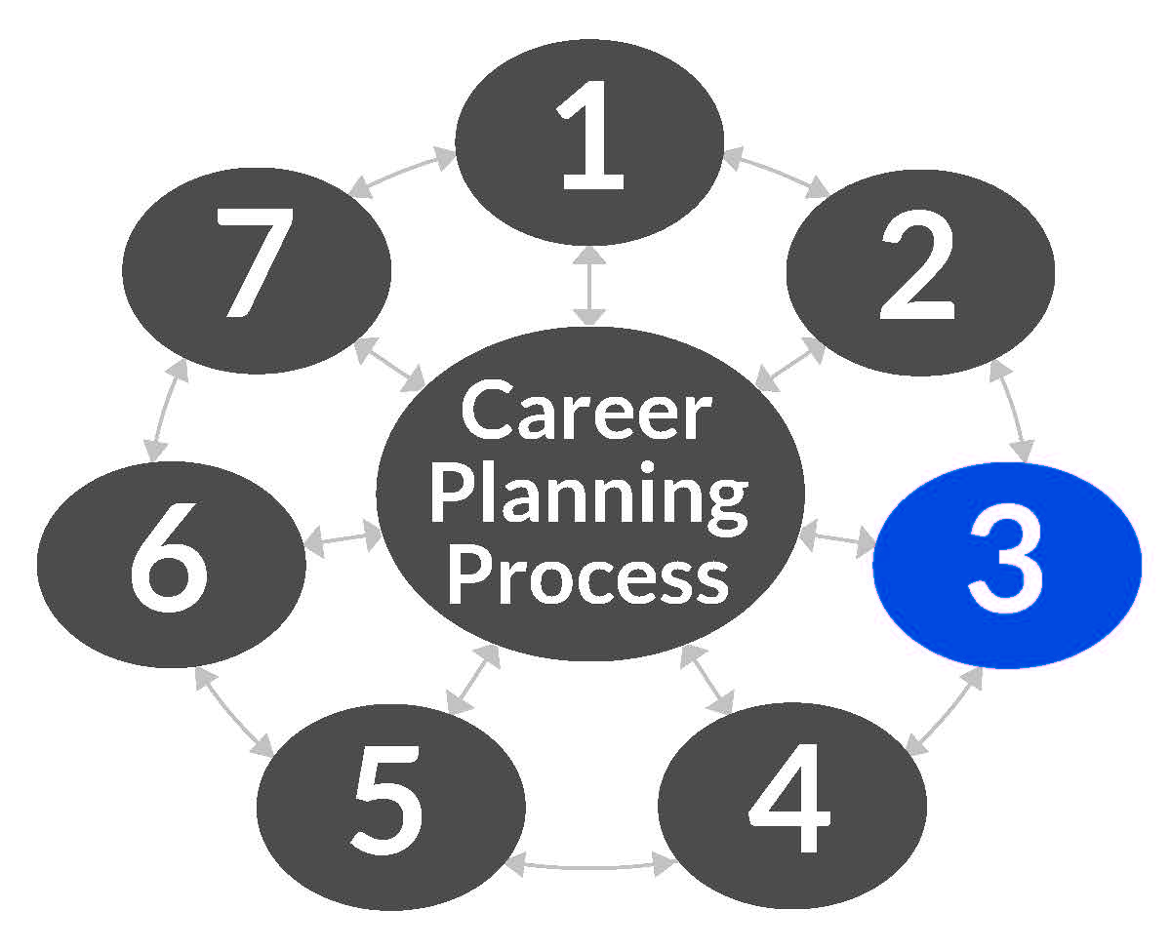
Step 3
Identify occupations to consider seriously.
Review your child’s assessment results.
Make sure your child is exploring and saving occupations of interest.

Slide 10
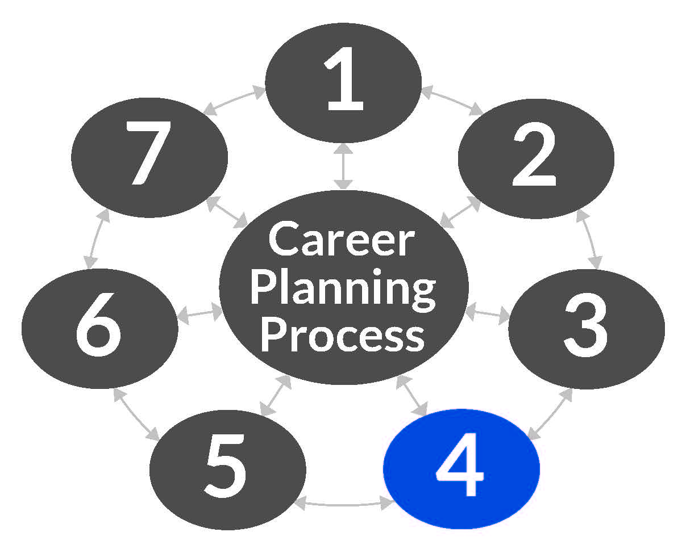
Step 4
Get detailed information about some occupations.
Review saved occupations together.
Watch an occupational video.

Slide 11
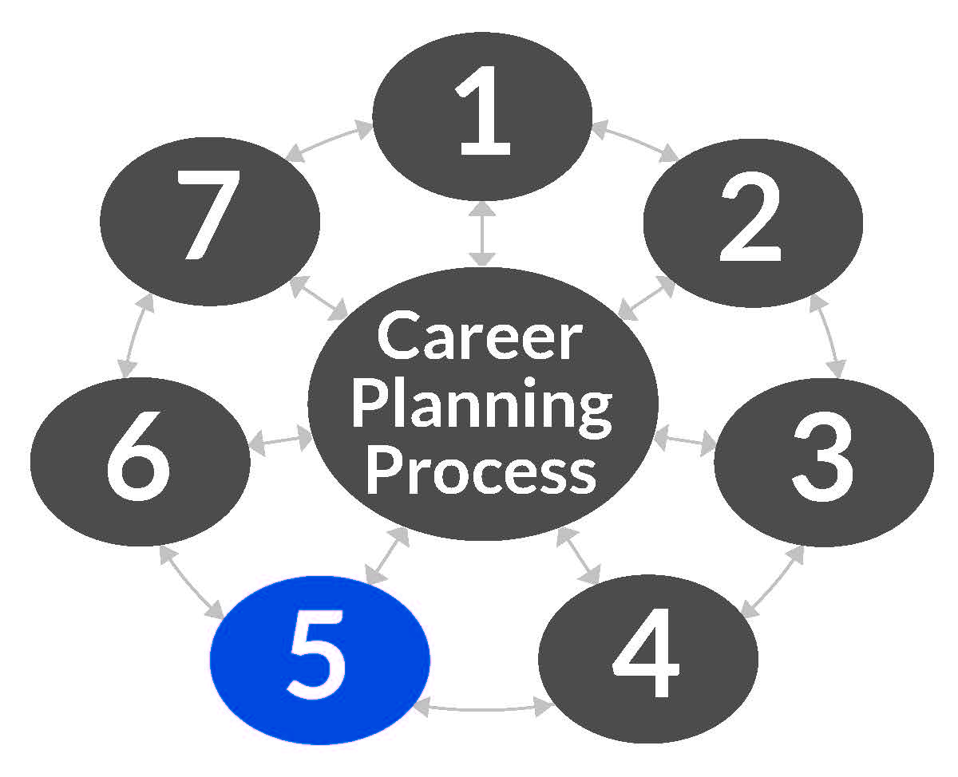
Step 5
Choose a short list of occupations.
Encourage your child to interview, job shadow, or participate in an internship for occupations that they are interested in.
Explore specific education, licensure, and certification requirements for these occupations.

Slide 12
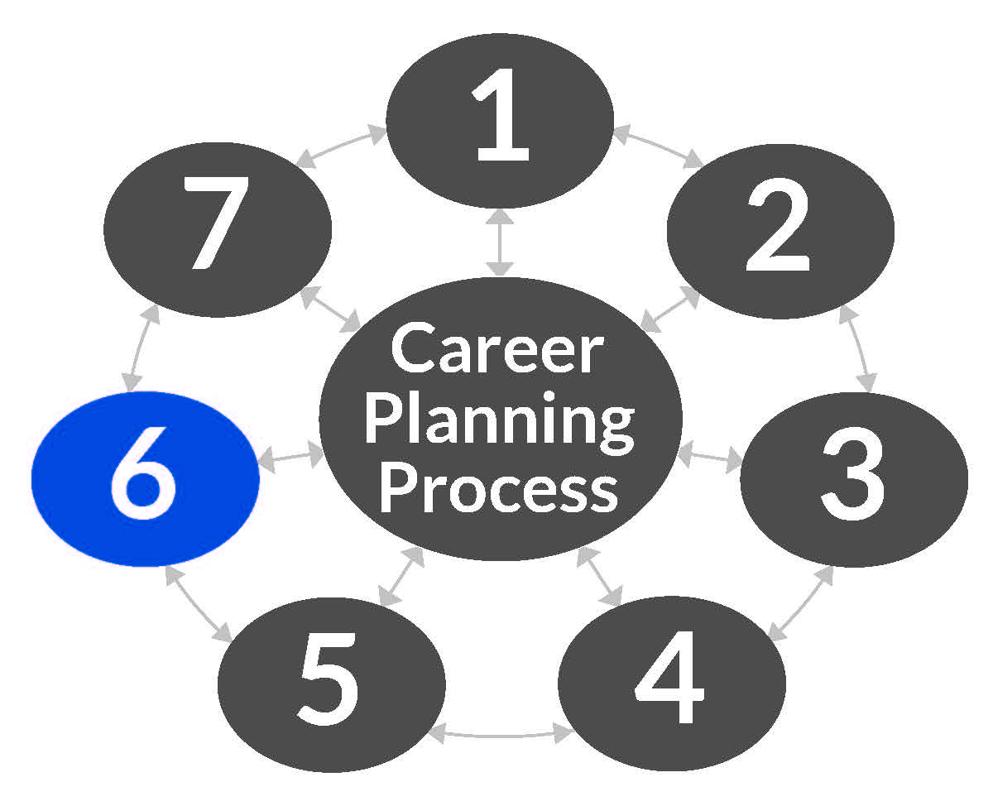
Step 6
Plan for future education.
Review suggested high school plans of study for career clusters.
Discuss all the options after high school and how to get there.

Slide 13
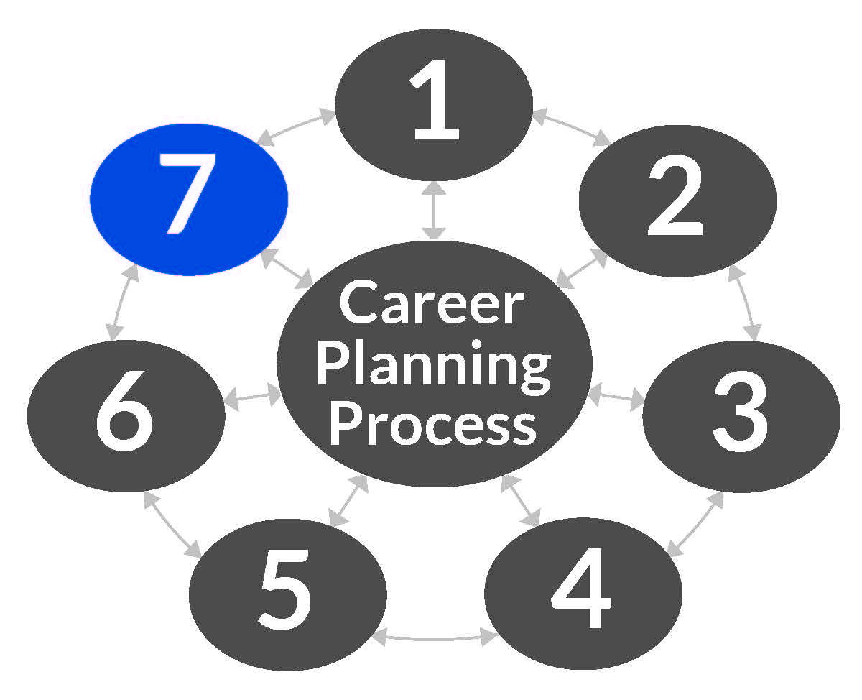
Step 7
Get a job.
Help your child understand what employers expect of their employees.
Discuss preparing for a job – using Kuder Navigator®, your child can learn interview skills, build a resume, and write a cover letter.
You can view your child’s resume from your parent account.

Slide 14
How can you help?

Slide 15
Get Involved!
Learn about Kuder Navigator and encourage your child to make the most of it.

Slide 16
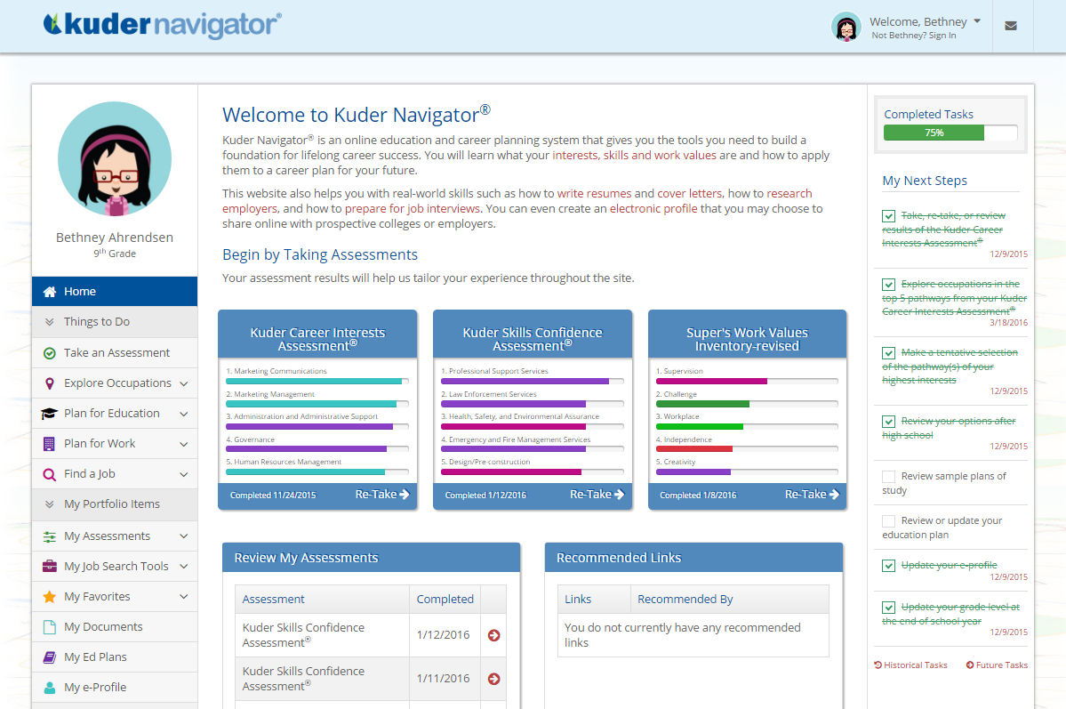
Kuder Navigator Homepage

Slide 17
About Kuder Navigator
Evidence-based guidance makes career planning fun, engaging, and relevant for middle school and high school students.
Learn About Yourself
Explore Occupations
Plan for Education
Plan for Work
Find a Job
Electronic Portfolio

Slide 18
About Kuder Navigator
77%
Students rated Navigator as helpful in making educational and career plans.
Students rated Navigator as helpful in motivating them to stay in school and choosing college majors.
76%
91%
Students rated Navigator as helpful in giving them
hope for their future.

Slide 19
Get Involved!
Activate your parent account in Navigator.
Review student progress on assessment results, education plans, and more.
Take a video tour of Navigator.
Get tips on how to support your child through the process.

Slide 20
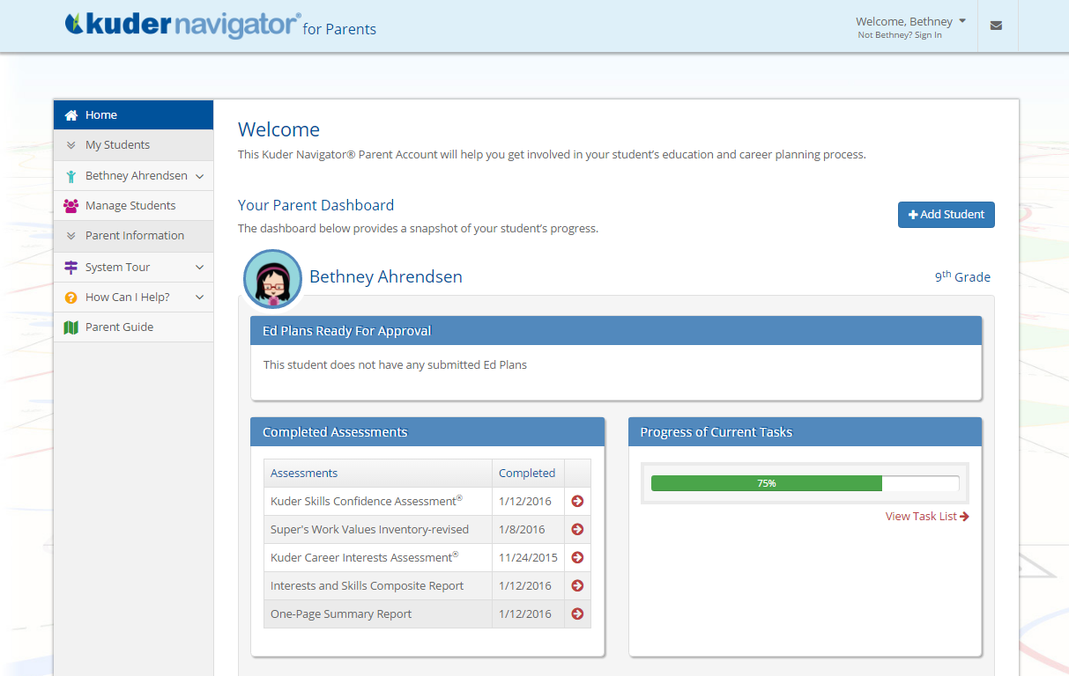
Parent Account: Homepage

Slide 21
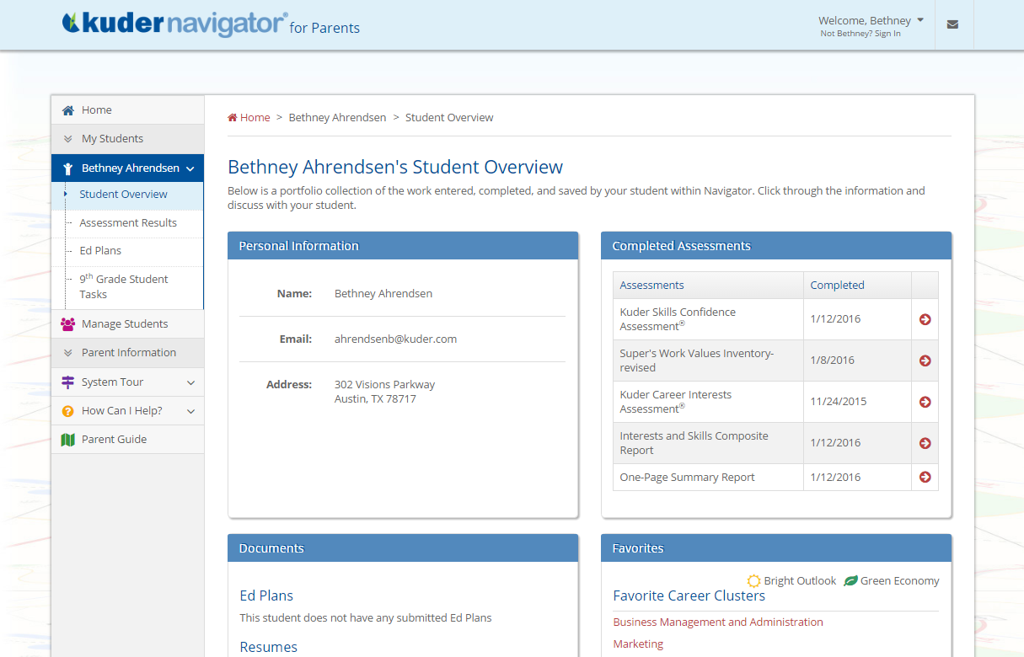
Parent Account: Student Overview

Slide 22
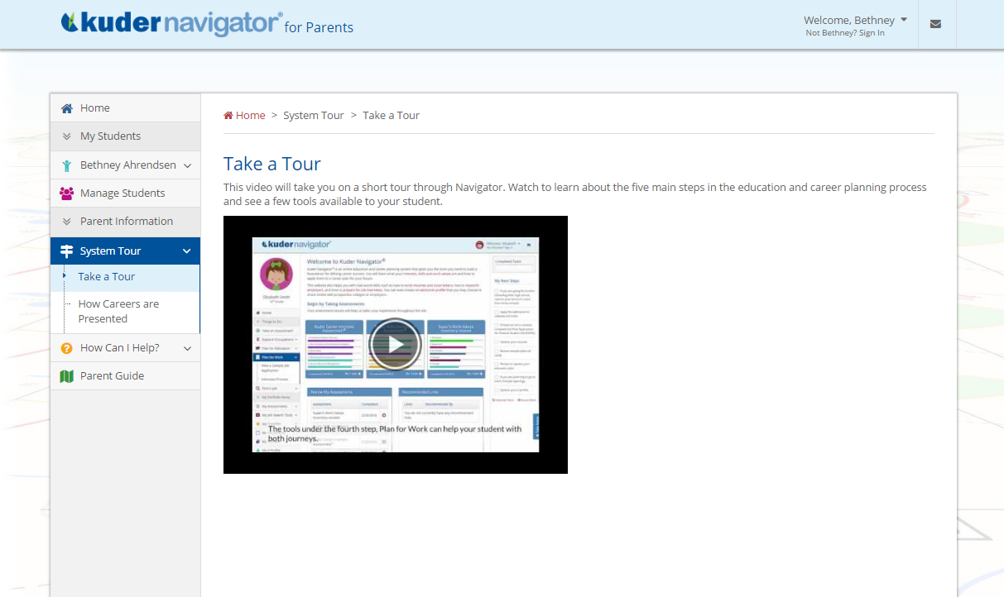
Parent Account: System Tour

Slide 23
Parent Account: Supporting My Next Steps

Slide 24
Thank you!
Questions?
Contact Information
Email Address
Telephone Number • website

